Slide 1


CORE COMPONENT
NGUYEN TRONG TIEN

Slide 2
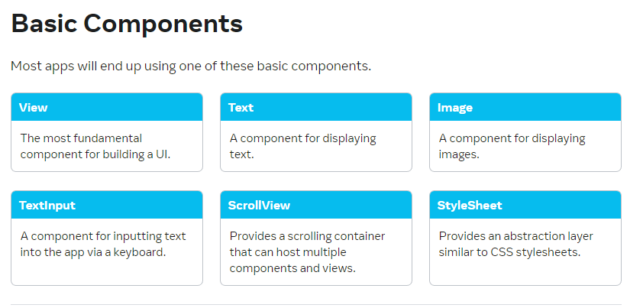
Core Components

Slide 3
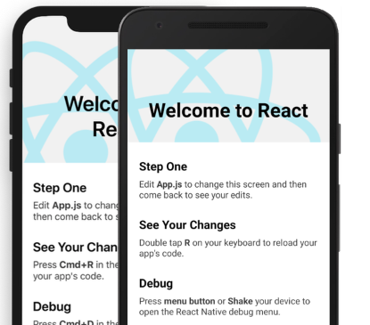
Documents
Ebook: React Native Cook book 2019
https://reactnative.dev/
https://docs.expo.dev/

Slide 4
Setting Up Your Environment
We will cover the following topics in this chapter:
Installing dependencies
Initializing your first application
Running your application in a simulator/emulator
Running your application on a real device

Slide 5
Technical requirements
We will cover the following topics in this chapter:
Expo
Android Studio
Node.js

Slide 6
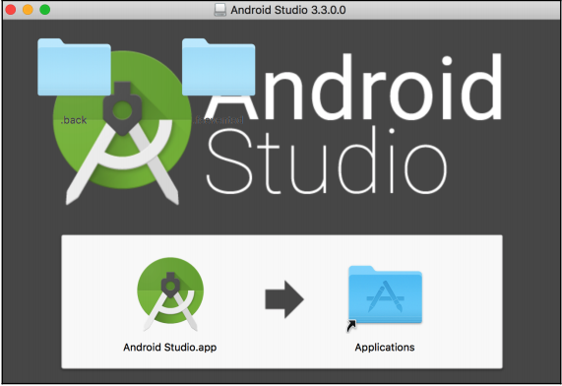
Installing Android Studio
Android Studio comes with the official Android emulator, which is the emulator that Expo recommends for use during development.
Download Android Studio from https://developer. android. com/studio/.
Open the downloaded file and drag the Android Studio.app icon to the Applications folder icon:

Slide 7

Installing Node.js
Node.js is a JavaScript runtime built on Chrome's V8 JavaScript engine, and is designed to build scalable network applications.
Node allows JavaScript to be executed in a Terminal, and is an indispensable tool for any web developer.
Downloading and installing Node.js from the project's site at https://nodejs.org/en/download/.

Slide 8
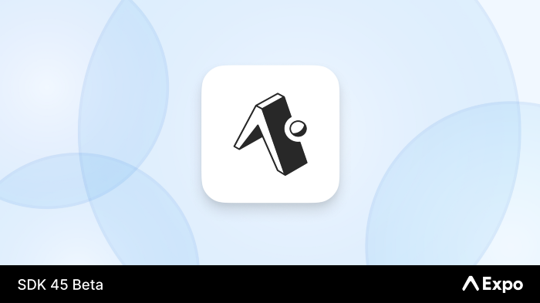
Installing Expo

Slide 9
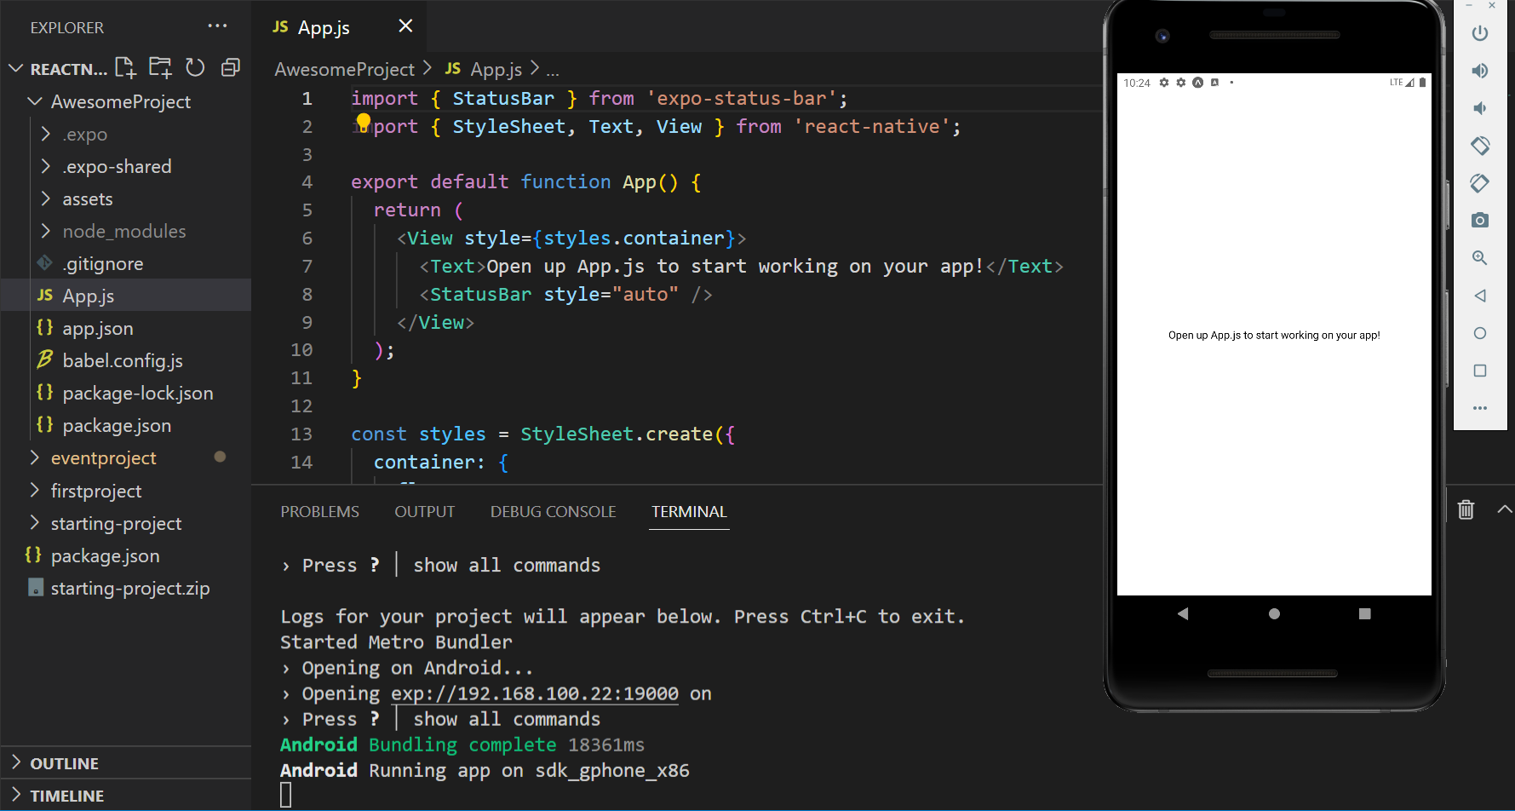
Edit slide
?

Slide 10
Initializing your first app
This is all the setup you need in order to get started developing your first React Native app using Expo! There are however a few extra steps you'll need to perform for working with pure React Native apps (non-Expo apps)
https://facebook.github.io/react-native/docs/getting-started. html

Slide 11
Initializing your first app
We'll create our first app using Expo via the Expo CLI. Making a new application is as simple as running the following:
expo init project-name

Slide 12
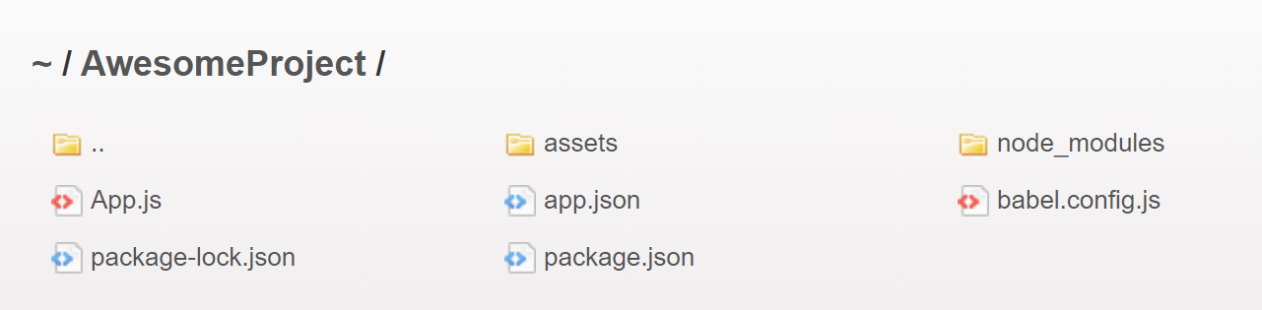
Project Structure

Slide 13
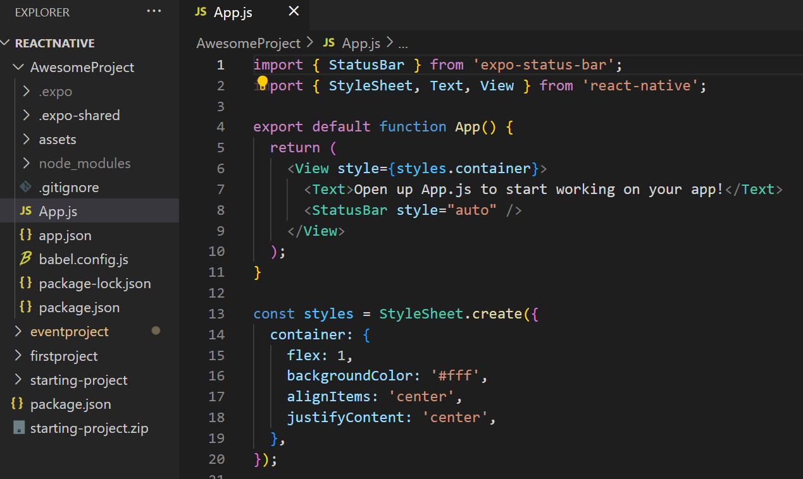

Slide 14
Running your app on a real device
You can get the in-development app running on your phone in three simple steps:
1. Open the App Store on your iPhone, or the Google Play Store on your Android device.
2. Search for and download the Expo Client app.
3. While your app is running on your development machine, you should also have the Expo Developer Tools open in a browser.

Slide 15
Running your app on a real device
- You should see a QR code at the bottom of the left-hand side menu of the Expo Developer Tools.
- Use the iPhone’s native Camera app, or the Scan QR Code button in the Expo Client app on Android, to scan the QR code. This will open your in-development app on the device within the Expo Client app

Slide 16
Creating a Simple React Native App
In this chapter, we'll cover the following recipes:
- Adding styles to elements
- Using images to mimic a video player
- Creating a toggle button
- Displaying a list of items
- Using flexbox to create a layout
- Setting up and using navigation
Notes:
React Native is a fast-growing library. Over the last few years it has become very popular among the open source community. There's often a new release every other week that improves performance, adds new components, or provides access to new APIs on the device. In this chapter, we'll learn about the most common components in the library. To step through all of the recipes in this chapter, we'll have to create a new application, so make sure you have your environment up and running.

Slide 17
Style
With React Native, you style your application using JavaScript. All of the core components accept a prop named style. The style names and values usually match how CSS works on the web, except names are written using camel casing, e.g. backgroundColor rather than background-color.

Slide 18
Style
The style prop can be a plain old JavaScript object. That's what we usually use for example code. You can also pass an array of styles - the last style in the array has precedence, so you can use this to inherit styles.

Slide 19
Style
The style prop can be a plain old JavaScript object. That's what we usually use for example code. You can also pass an array of styles - the last style in the array has precedence, so you can use this to inherit styles.

Slide 20
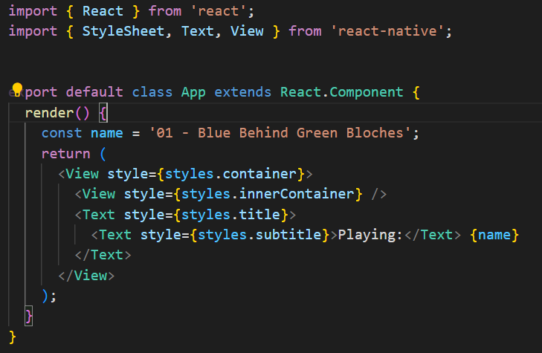
How to do it...

Slide 21
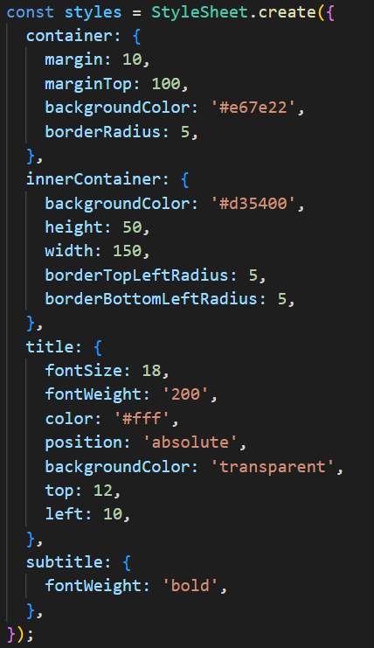
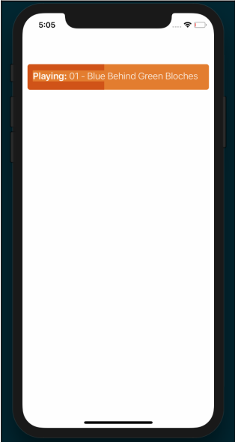
How to do it...

Slide 22
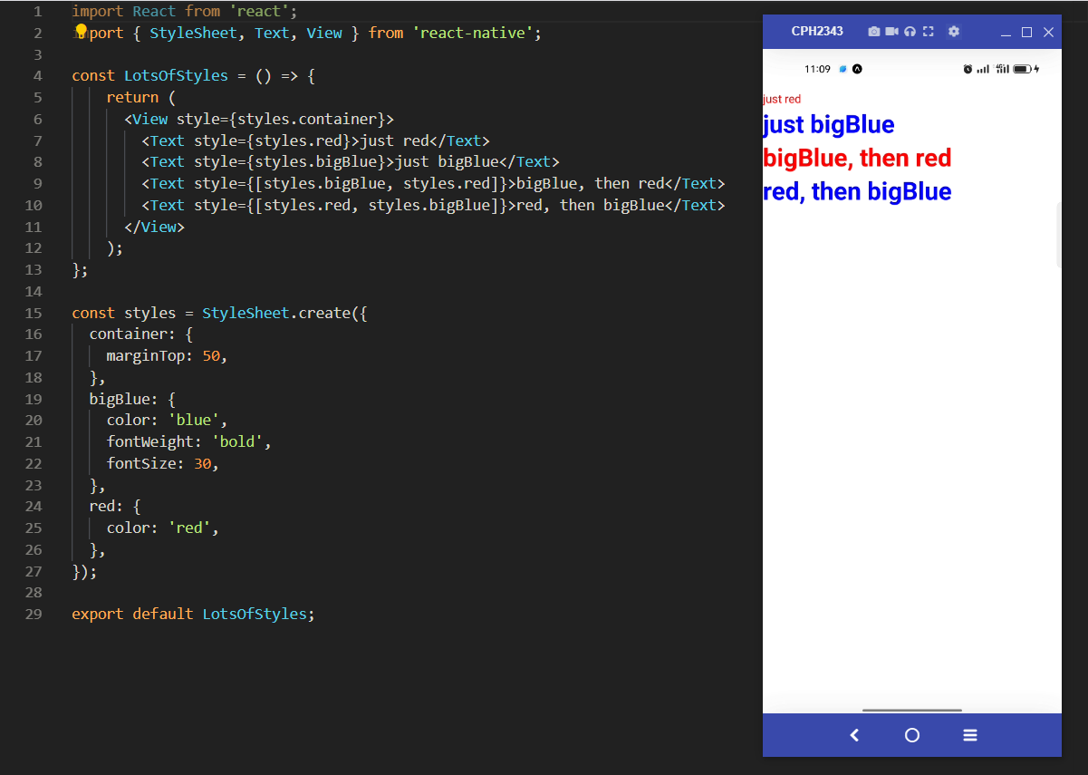
Style

Slide 23

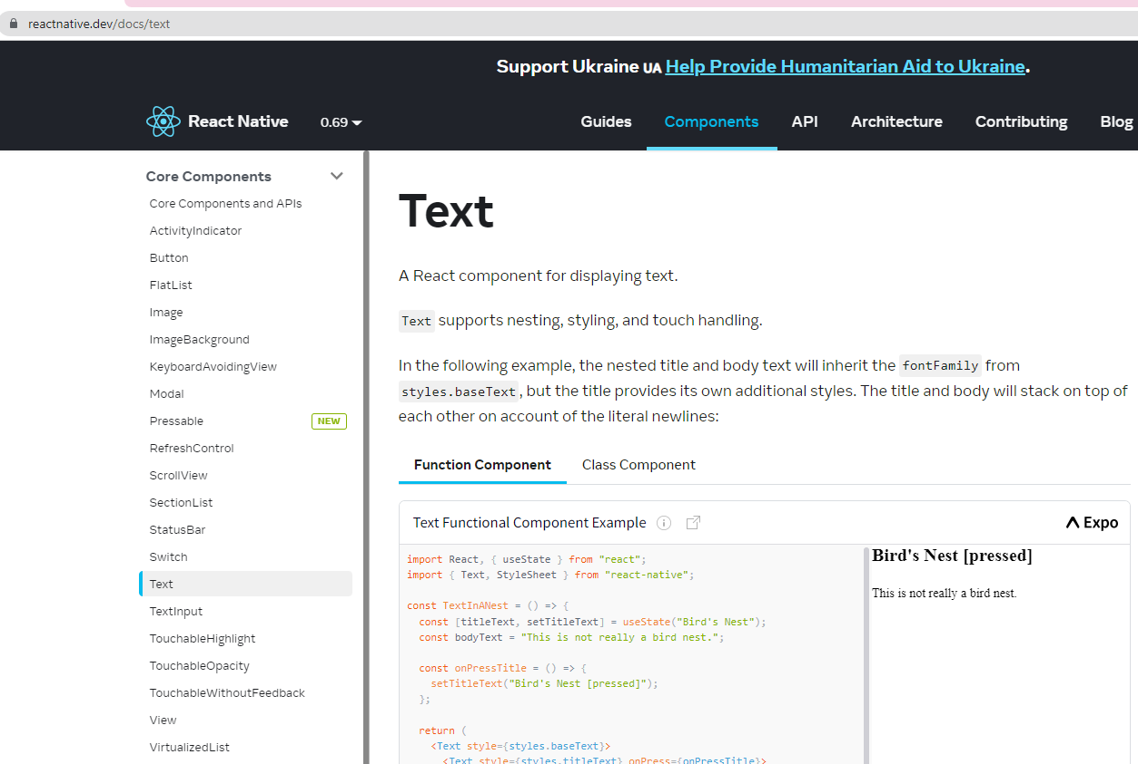
CORE COMPONENTS –STYLE AND COLOR

Slide 24
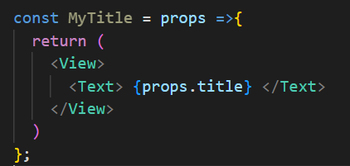
Working with Core Components
View
Text
Button
TextInput
Image
…………

Slide 25

STYLING REACT NATIVE APPS
INLINE STYLES
STYLESHEET OBJECTS

Slide 26
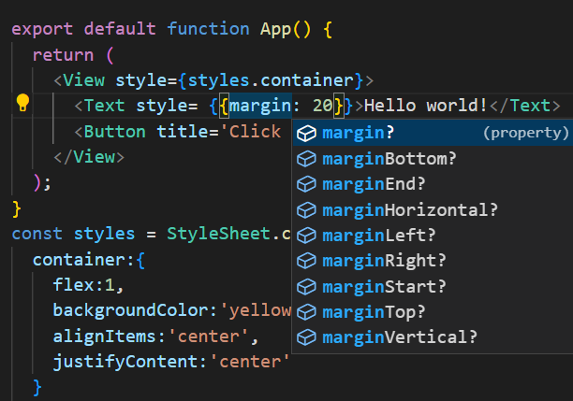
INLINE
{{….}}

Slide 27
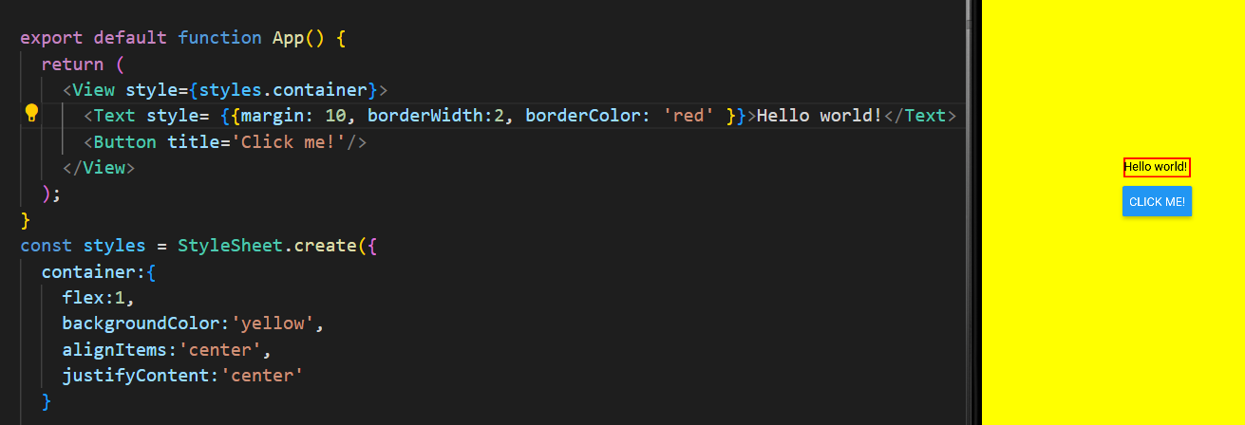
INLINE

Slide 28
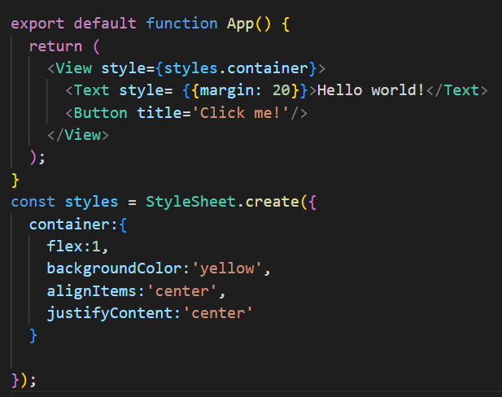
STYLESHEET
container

Slide 29
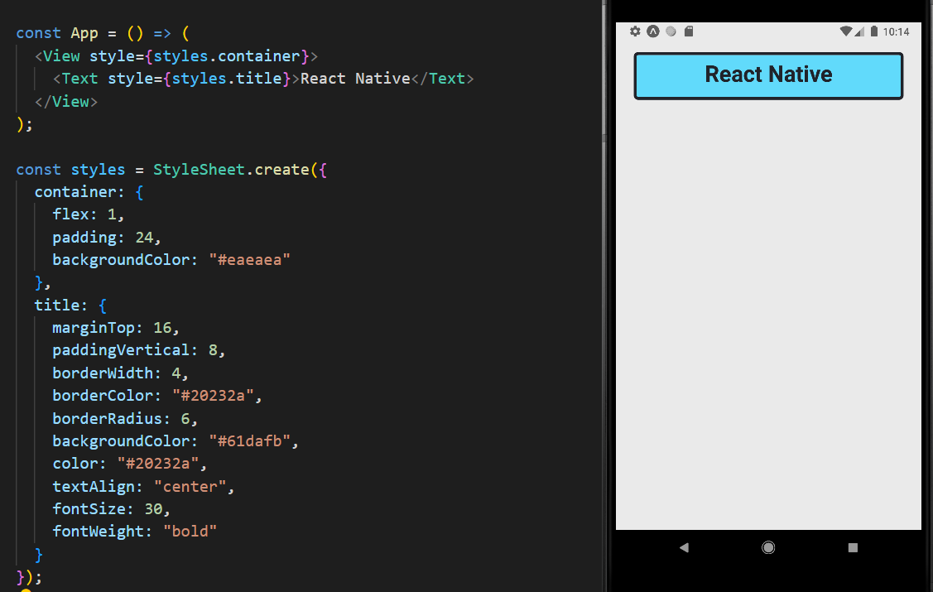
STYLESHEET

Slide 30

Core Components, Styling & Colors - More Information
- Official styling documentation: https://reactnative.dev/docs/style
- Official article about "Colors" to learn about different ways of setting & using colors in React Native apps: https://reactnative.dev/docs/colors

Slide 31
Core Components, Styling & Colors - More Information
official API reference articles for the different core components https://reactnative.dev/docs/view
https://reactnative.dev/docs/view#style): https://reactnative.dev/docs/view-style-props

Slide 32
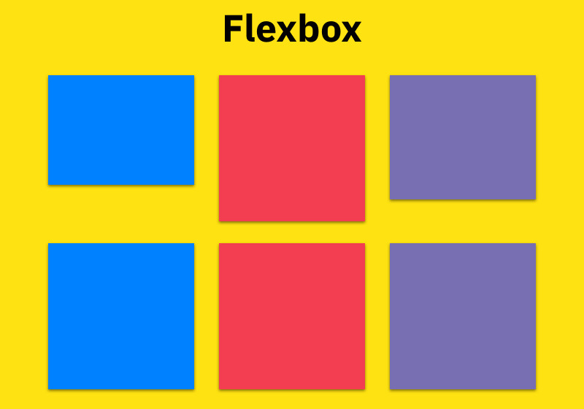
EXPLORING LAYOUTS & FLEXBOX
- Layouts are created with Flexbox
Very similar to browser CSS Flexbox
Elements are positioned inside of containers

Slide 33
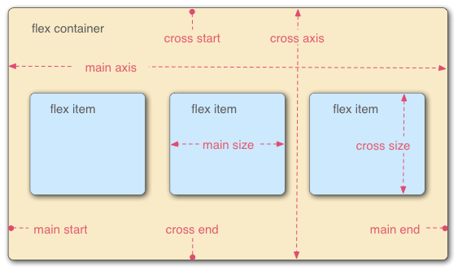
Flexbox

Slide 34
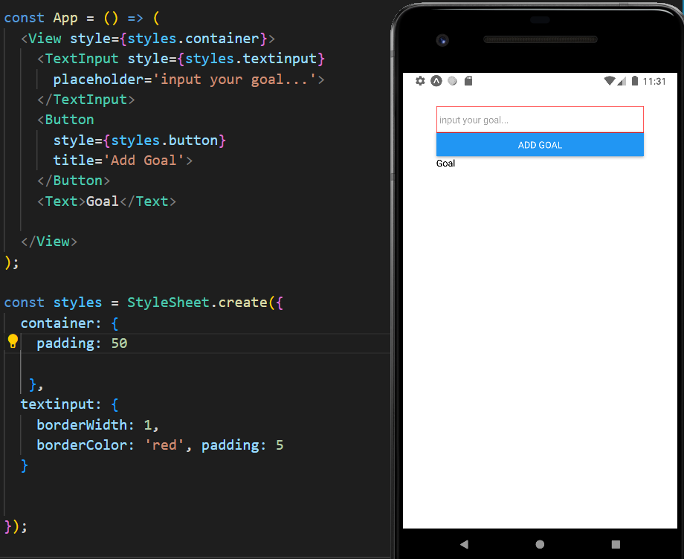
Using Flexbox to create Layout

Slide 35
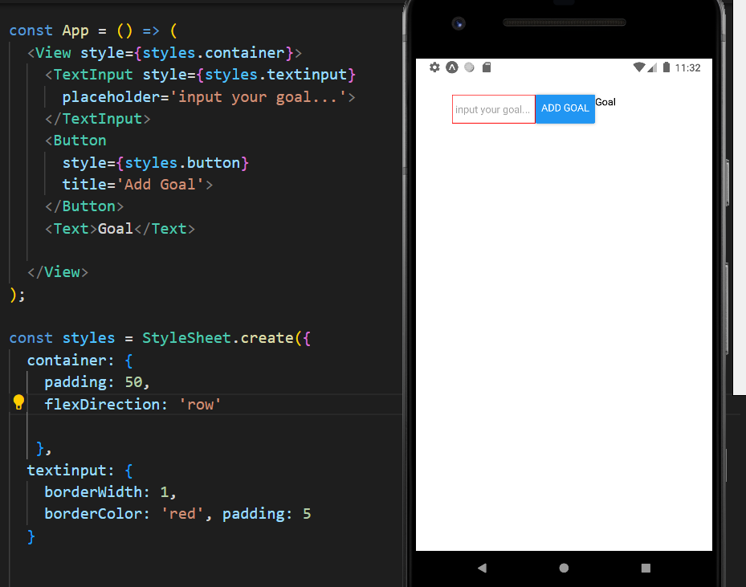
flexDirection: 'row'

